Slide 1

Wifi based motion alarm
Mahir Mohammad Faisal Rahman 1731014
Rafiqul Hassan Bhuiyan 1520140
Jisan Haider Joy 1731447
Nazia Afrin Nikita 1620800

Slide 2
Description
In our project, we are going to learn how to make an Internet of things motion sensor which will give us alert on our phone when motion is detected at the place we installed the sensor. Everything works through the internet so there is no limitation of the distance between the sensor and the phone.

Slide 3

Components

Slide 4

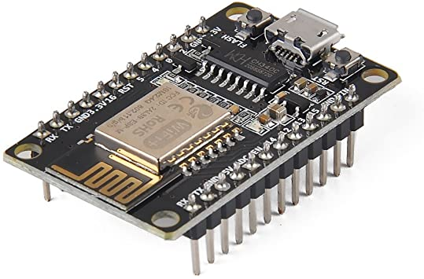
ESP8285 ESP-M2 Development Board

Slide 5
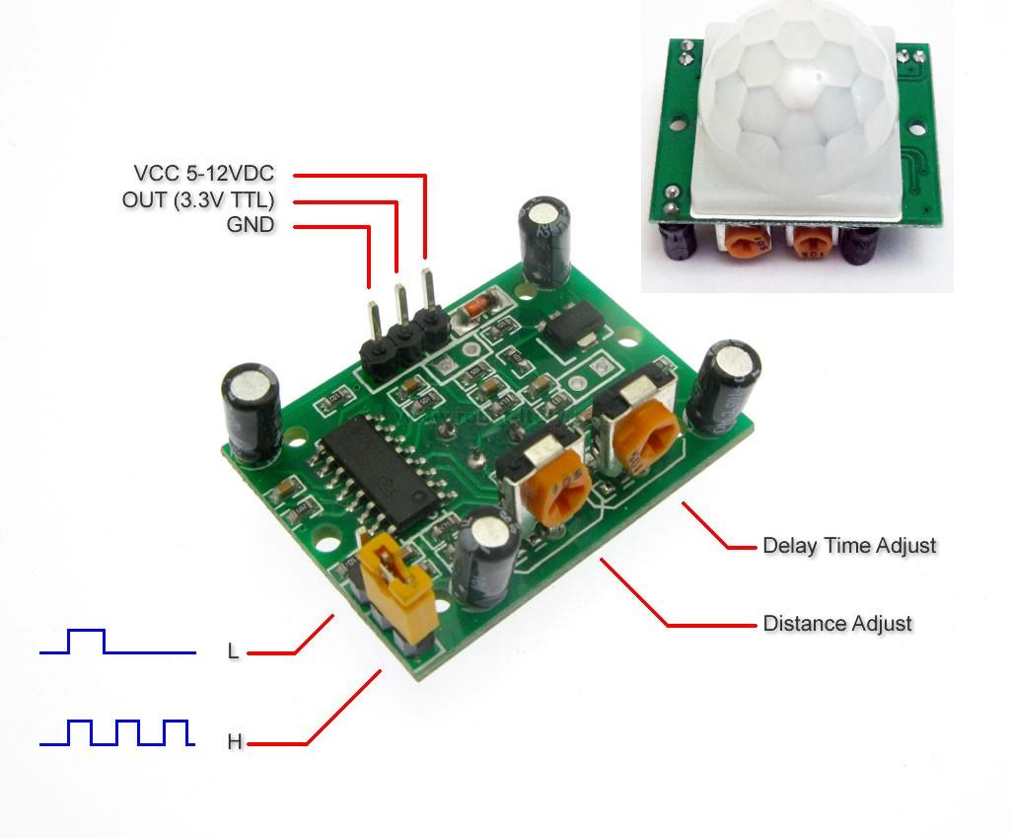
HC-SR501 PIR Sensor Module

Slide 6
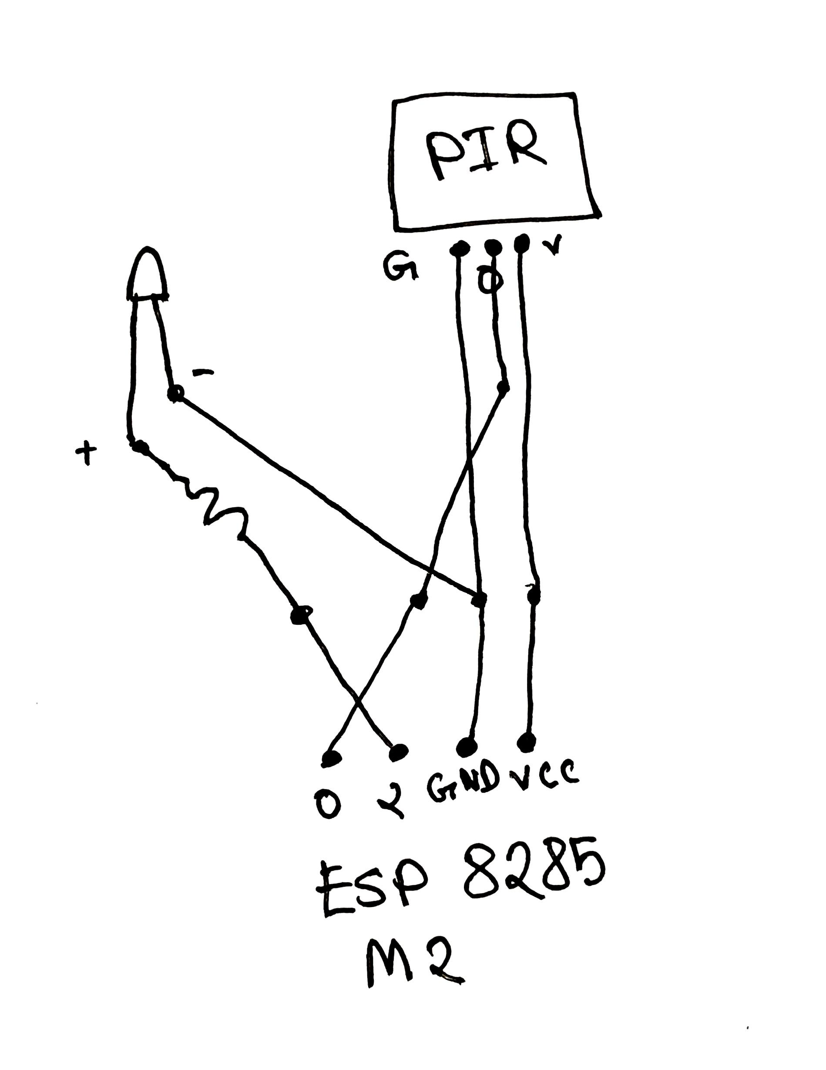
Circuit Design

Slide 7
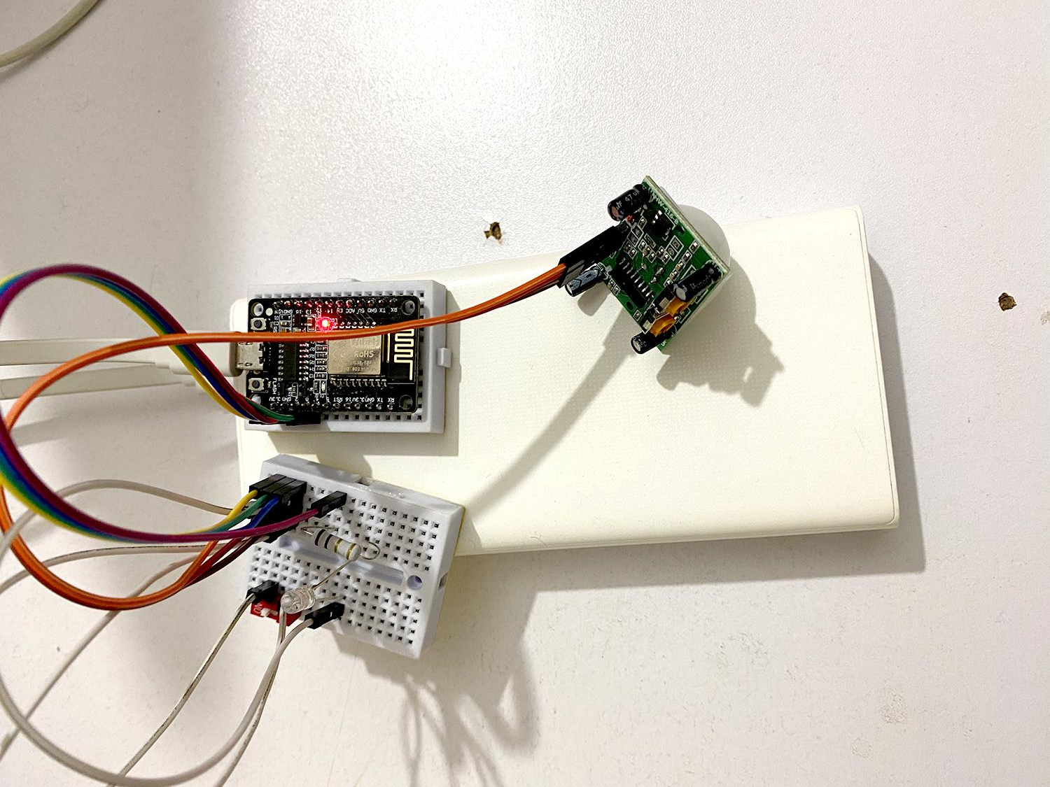
Picture of our assembled Project

Slide 8
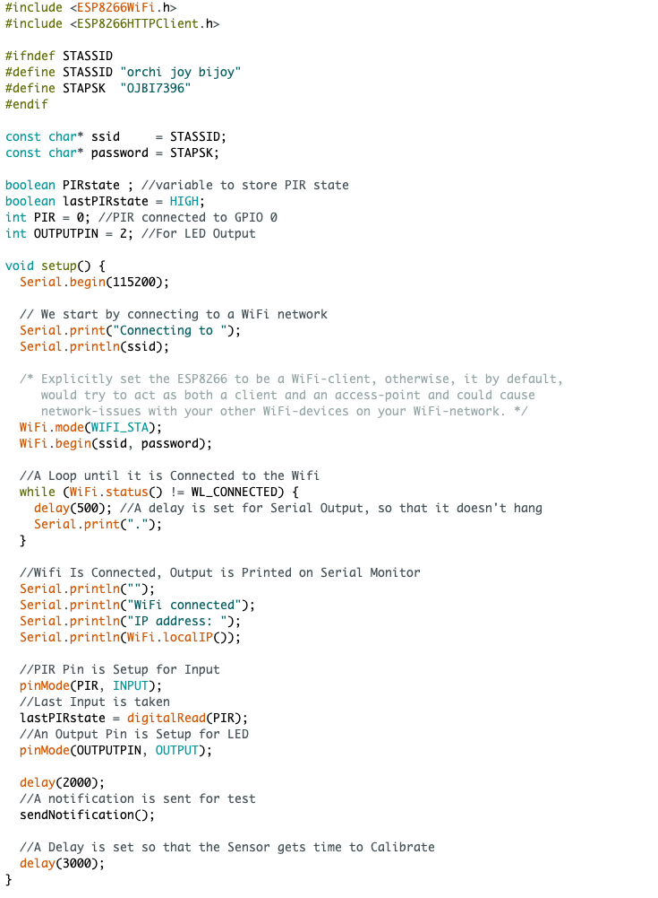
Code

Slide 9

Code

Slide 10
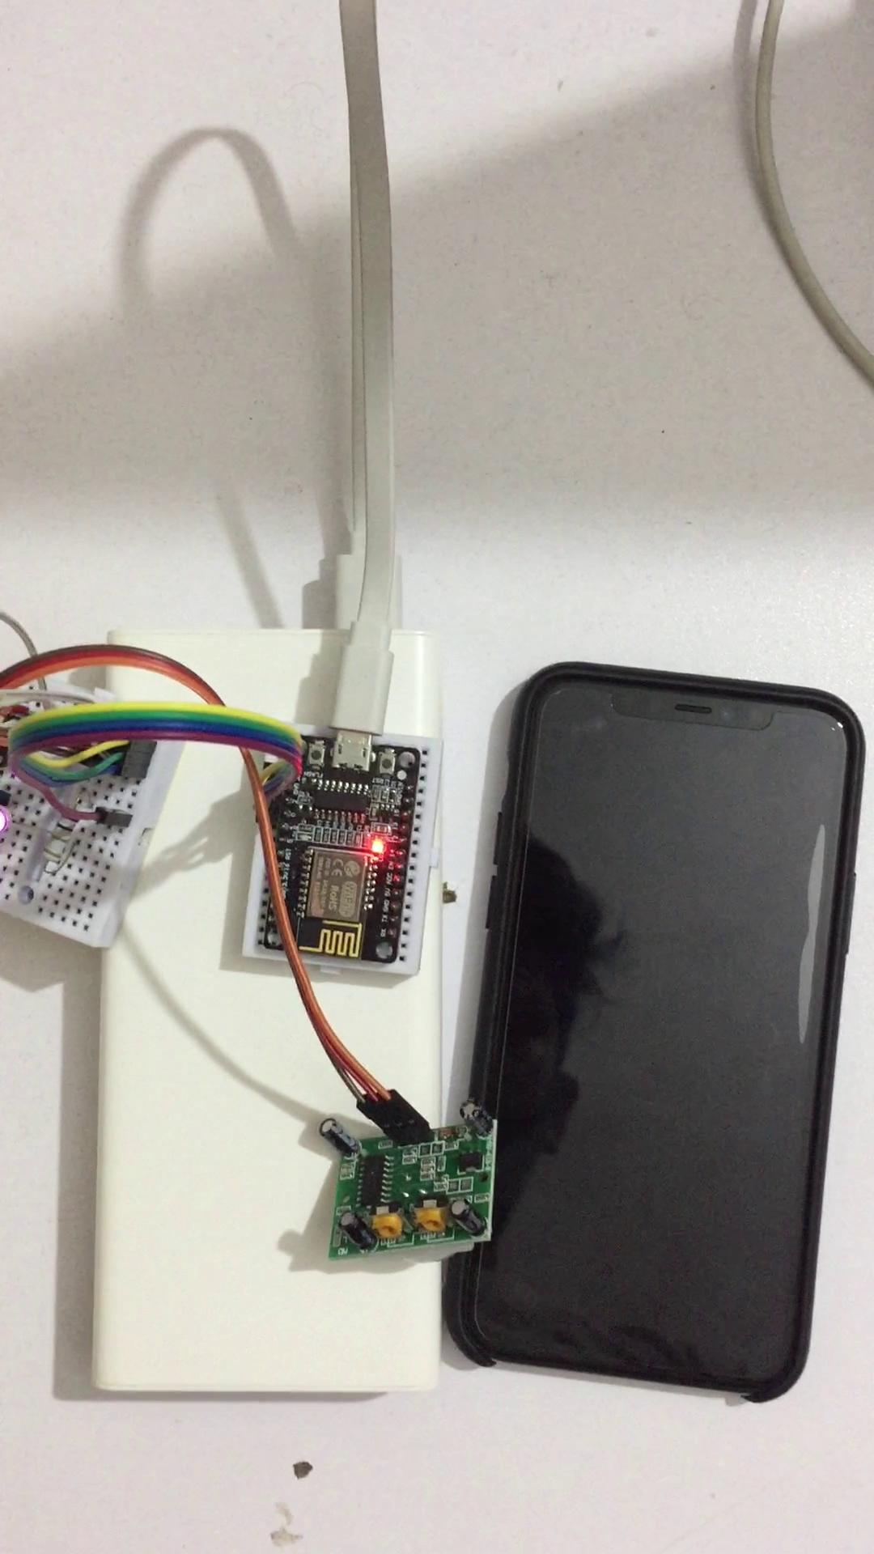
Video

Slide 11
Major Challenges
Finding the ESP8285 ESP-M2 Development Board
Setting the fragile ESP8285 on breadboard
Testing HC-SR501 PIR Sensor Module
Getting the PIR sensor module to detect motion and output correctly

Slide 12
Learning
IFTTT Applet Creation
Obtaining the HTTP GET request URL
Configuring WIFI and setting static address
ESP8285 ESP-M2 Development Board Applications
HC-SR501 PIR Sensor Module Configuration
Circuit Connection
Importing Arduino Library

Slide 13
Applications
Intruder alarms
Car Parking
Security lighting
Automatic doors
Hand dryers

Slide 14
Thank you

